Slide 1
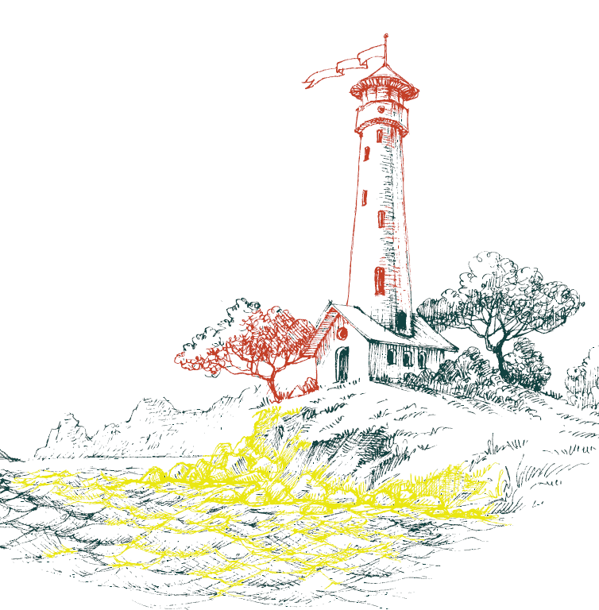
EurOcean
RID
Adding value to marine infrastructure initiatives.
Sandra Sá - sandra.sa@eurocean.org
Knowledge Services Officer

Slide 2
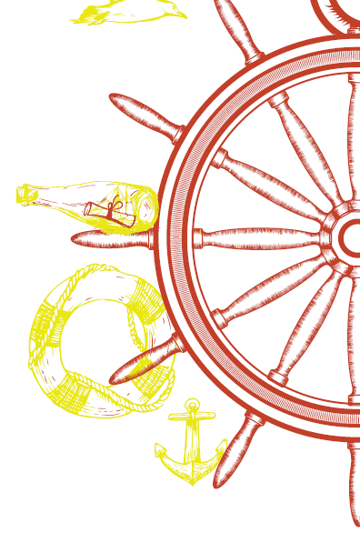
Evolution of four infrastructures databases
2006
Research Vessels (373)
Exchangeable Equipment (109)
Aquaculture Facilities(151)
Research Infrastructure Database (916 )
2014

Slide 3
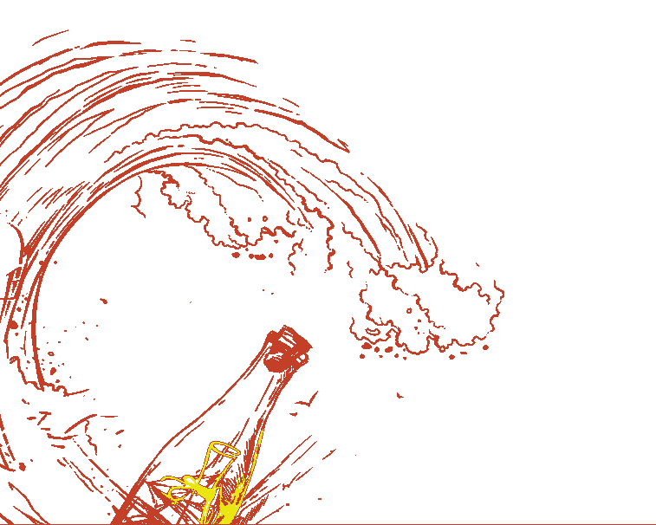
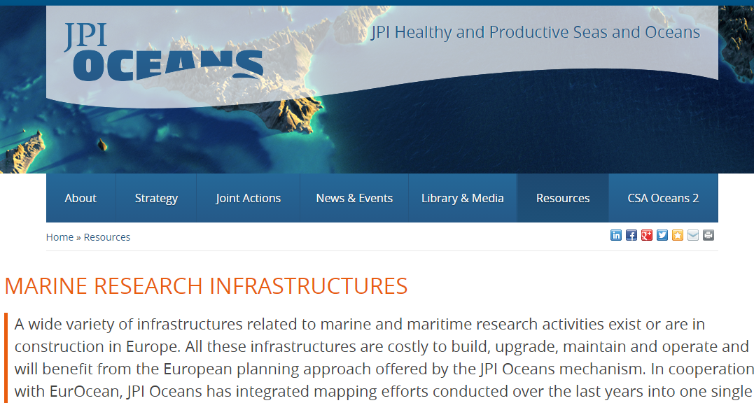
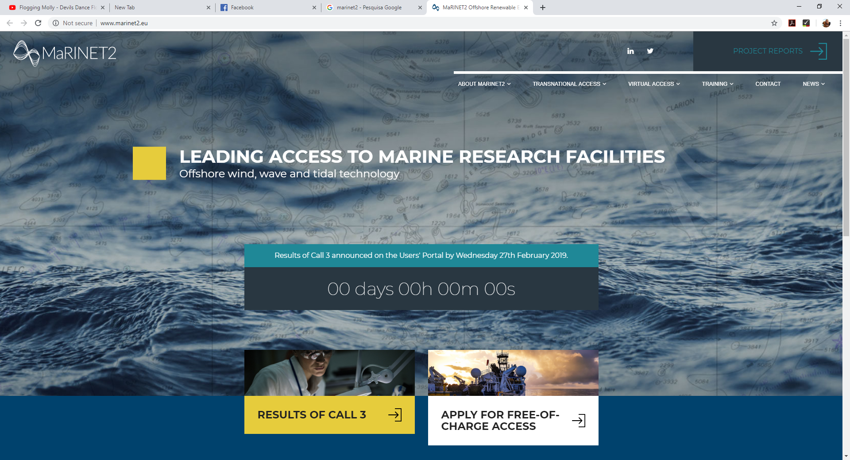
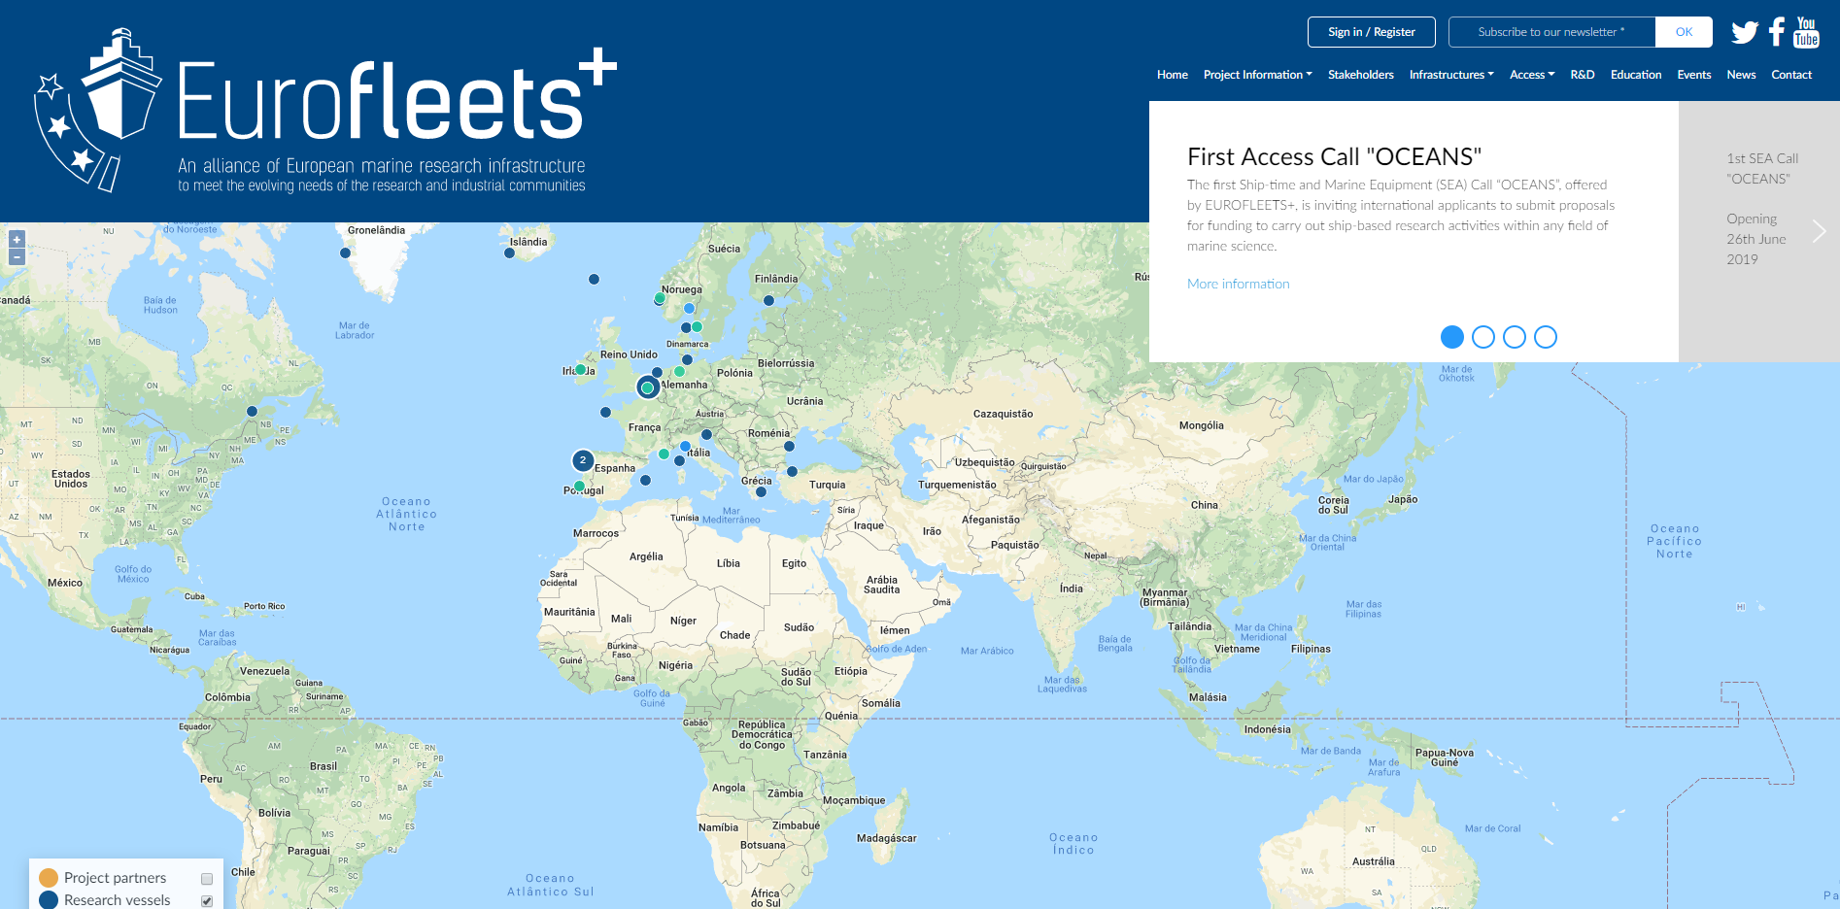
Adding Value to Other Initiatives

Slide 4
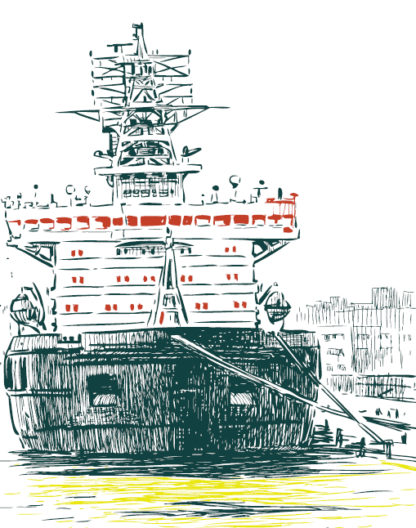
Evolution of four infrastructures databases
Recurring extra work to maintain, update and homogenise the 4 InfoBases, each having their own source file;
Remaining discrepancies between the InfoBases due to different definitions or interpretation of some descriptors;
Features and design in need of update for the oldest InfoBases.
The challenge was to develop an integrated system in order to unify both the source files and the online InfoBases and interfaces.

Slide 5
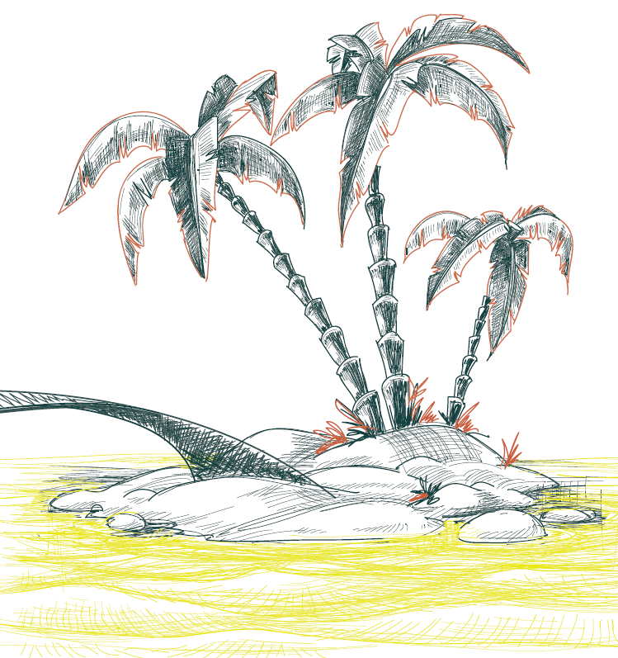
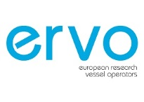
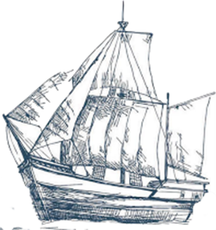
Collaborations for the development of a proposal

Slide 6
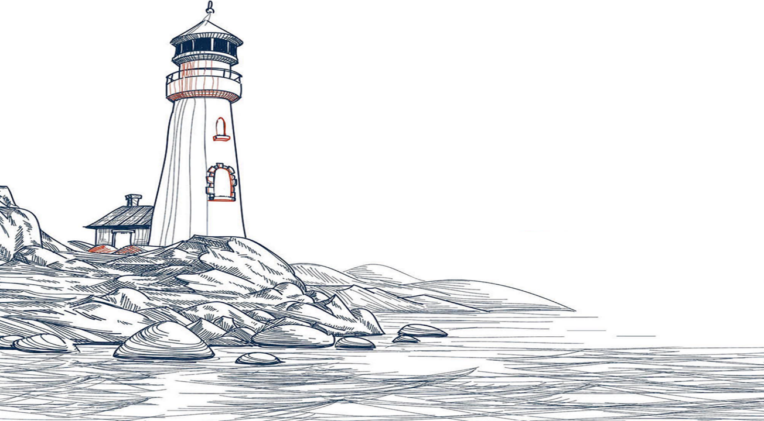
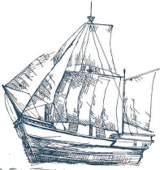
Fifteen Infrastructure Categories are Included
Research Vessels
Underwater vehicles and large equipment
Fixed point open ocean observatories
Mobile ocean observatories
Coastal observatories
Deep ocean drilling research facilities
Satellites for seas and oceans observation
Marine data providers
Flumes and test labs for ocean engineering
In situ test sites for ocean renewable energy
Marine biology stations
Aquaculture research facilities
Marine mesocosm facilities
Basins
Other

Slide 7
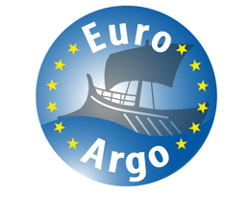
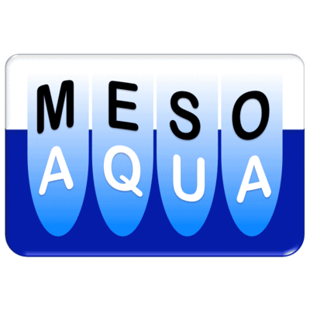
These align with key EU Projects and Initiatives

Slide 8
Typical Common Information Available
Name
Owner
Operator
Operator status
Category
Type
Country
Main operating areas
Main scientific disciplines addressed
Contact person
Operator URL
Infrastructure URL
First Year of service
Year of last refit
Length (m)
Max. Operating depth (m)
Service currently offered by the infrastructure
Access conditions
Examples of scientific data acquired
Logo of operator
Photo of infrastructure
Location (hometown)
Latitude
Longitude
Last Update of the information:

Slide 9
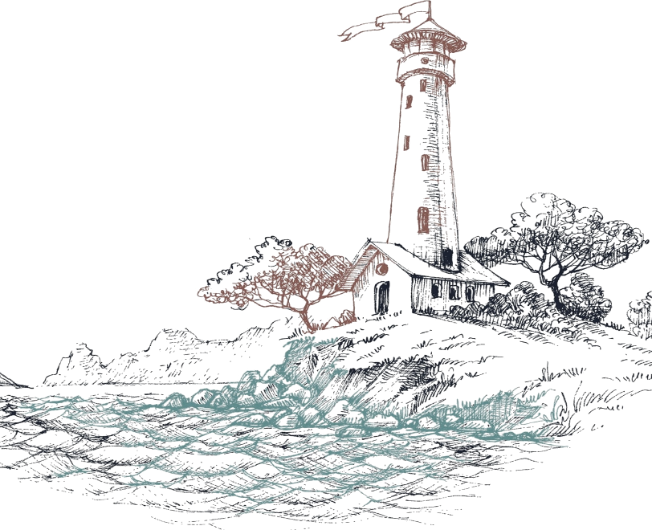
What’s in it for you?

Slide 10
Specialised (RV) Information for Some Categories
Ship information >>>
Vessel status *
Technical capacities *
Vessel Type *
ICES Shipcode
MMSI Number
IMO Number
NODC Code
Call Sign
URL Schedule
Class Notation
Main Characteristics >>>
Length (m)
Breadth (m)
Max displacement (tons)
Gross Tonnage
Freeboard to Work Deck (m)
Draft (m)
Hull Material
Electrical propulsion (Yes/No)
Dynamic Position
Silent Ship Operation Abilities
Capacity Dry Cargo Area (m3)
Fuel Capacity (m3)
Water Capacity (m3)
Water Gen (m3)

Slide 11
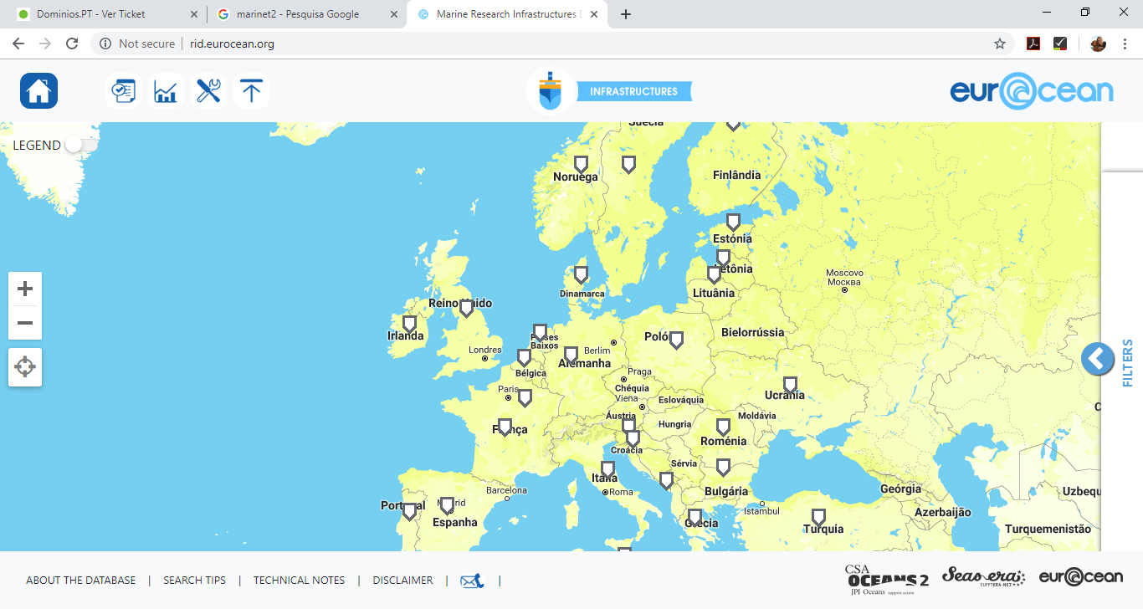
Visit the New RID

Slide 12
A Series of Search Filters are Implemented (Basic and Advanced)

Slide 13
Other Features
Realtime Infographics
Scientific Capacities
Affiliation
Realtime positioning
Owner
Status
Standardization

Slide 14
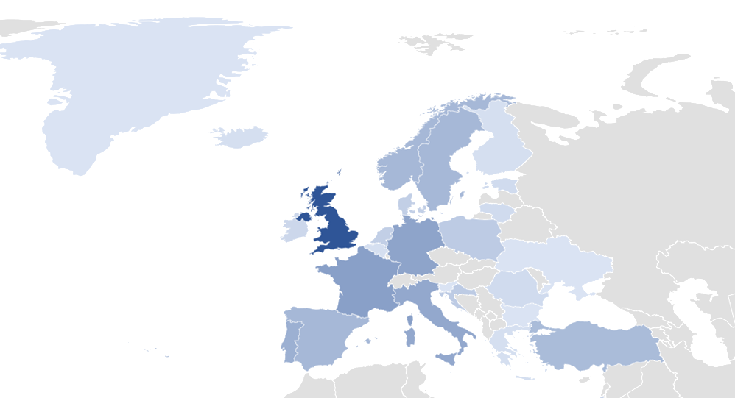
What’s in there?

Slide 15
What’s in there?

Slide 16
Knowledge Services on Research Infrastructures
Information on 1022 infrastructures, from 38 countries worldwide, distributed over 15 categories;
Free of charge access to our Marine Research Infrastructures Database;
Technical characteristics; services offered by the operator; availability and contact points;
The level of detail and completeness of the information available may vary according to the operator and type of infrastructure;
Services tailored to customers’ needs.
Taking advantage of our privileged access, in-depth knowledge of the database, and of the tools and techniques developed over time, we search, organize and provide relevant and meaningful information that fully meets our customers’ requirements on a timely and cost-effective manner.

Slide 17
http://rid.eurocean.org

